Slide 1
Projectile Motion Notes

Slide 2
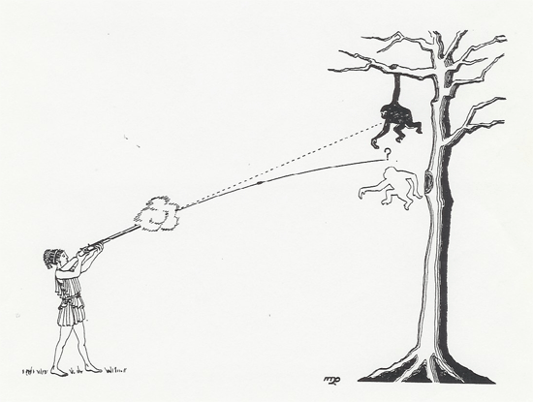
What is a projectile?
A projectile is any object which once projected or dropped continues in motion by its own inertia and is influenced only by the downward force of gravity.

Slide 3
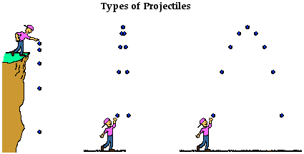
An object dropped from rest is a projectile (provided that the influence of air resistance is negligible).
An object which is thrown vertically upward is also a projectile (provided that the influence of air resistance is negligible).
An object is which thrown upward at an angle to the horizontal is also a projectile (provided that the influence of air resistance is negligible).

Slide 4
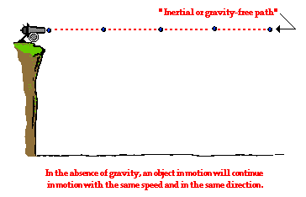
Projectile Motion

Slide 5
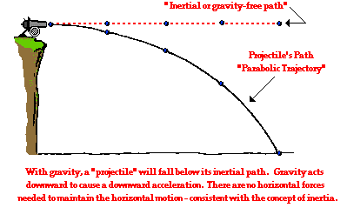
Projectile Motion

Slide 6
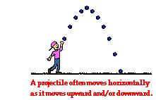
Characteristics of a Projectile's Trajectory
Many projectiles not only undergo a vertical motion, but also undergo a horizontal motion. That is, as they move upward or downward they are also moving horizontally.
There are the two
components of the
projectile's motion –
horizontal and vertical
motion.

Slide 7
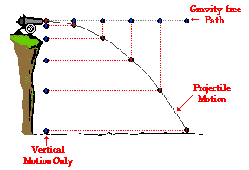
Horizontally Launched Projectiles
Consider a cannonball projected horizontally by a cannon from the top of a very high cliff.
The projectile travels with a constant horizontal velocity and a downward vertical acceleration.

Slide 9
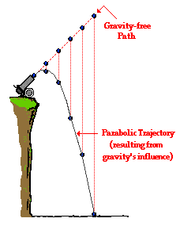
Non-Horizontally Launched Projectiles
Consider the cannon is aimed upward and shot at an angle to the horizontal from the same cliff.
The projectile would travel
with a parabolic trajectory.

Slide 11
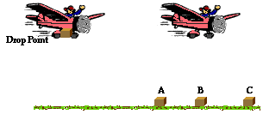
Practice
Suppose a rescue airplane drops a relief package while it is moving with a constant horizontal speed at an elevated height. Assuming that air resistance is negligible, where will the relief package land relative to the plane?

Slide 13


